Slide 1
Welcome
to Cedar
Confidential. Not for distribution.

Slide 2
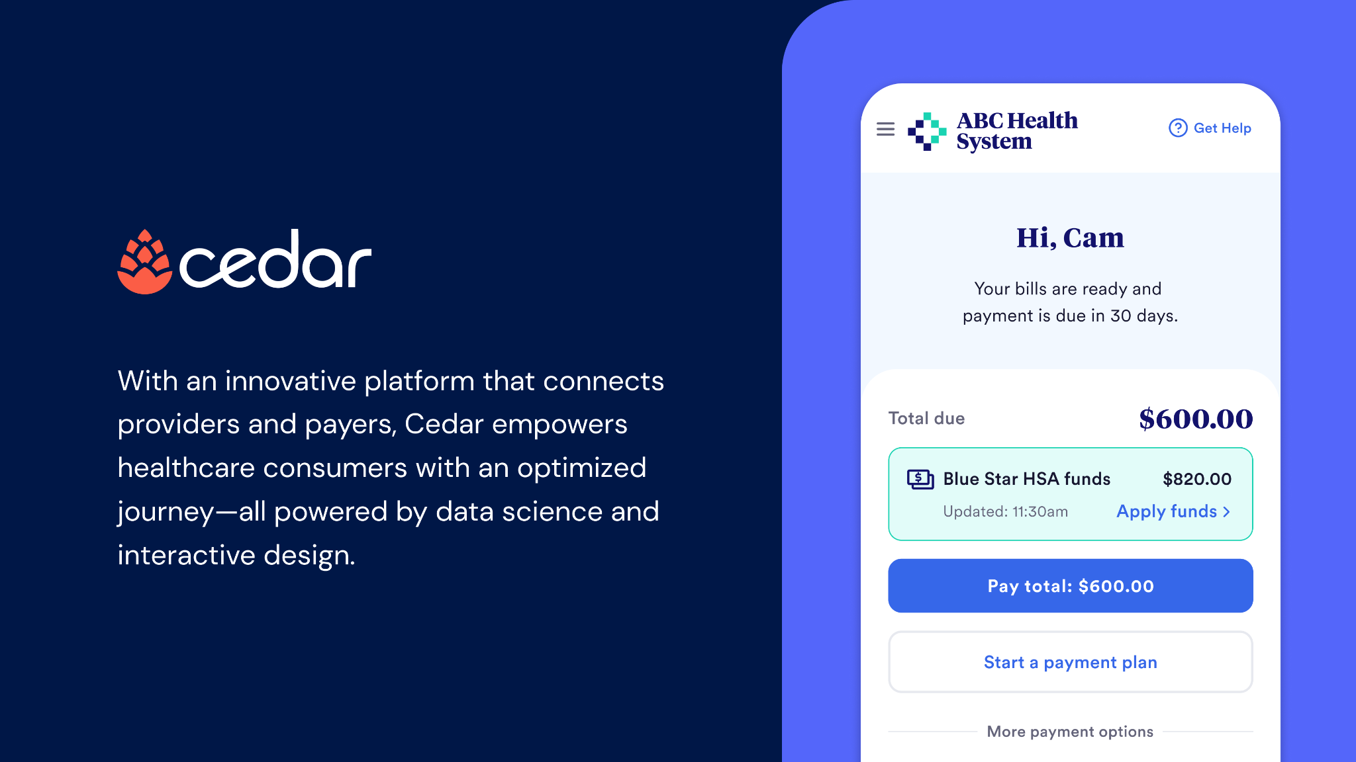

Slide 3






















Providers
Cedar’s mission is to empower us all to easily and affordably pursue the care we need
Payers
55+
client partners
30m+
Patients served per year
World-class investors

Slide 4
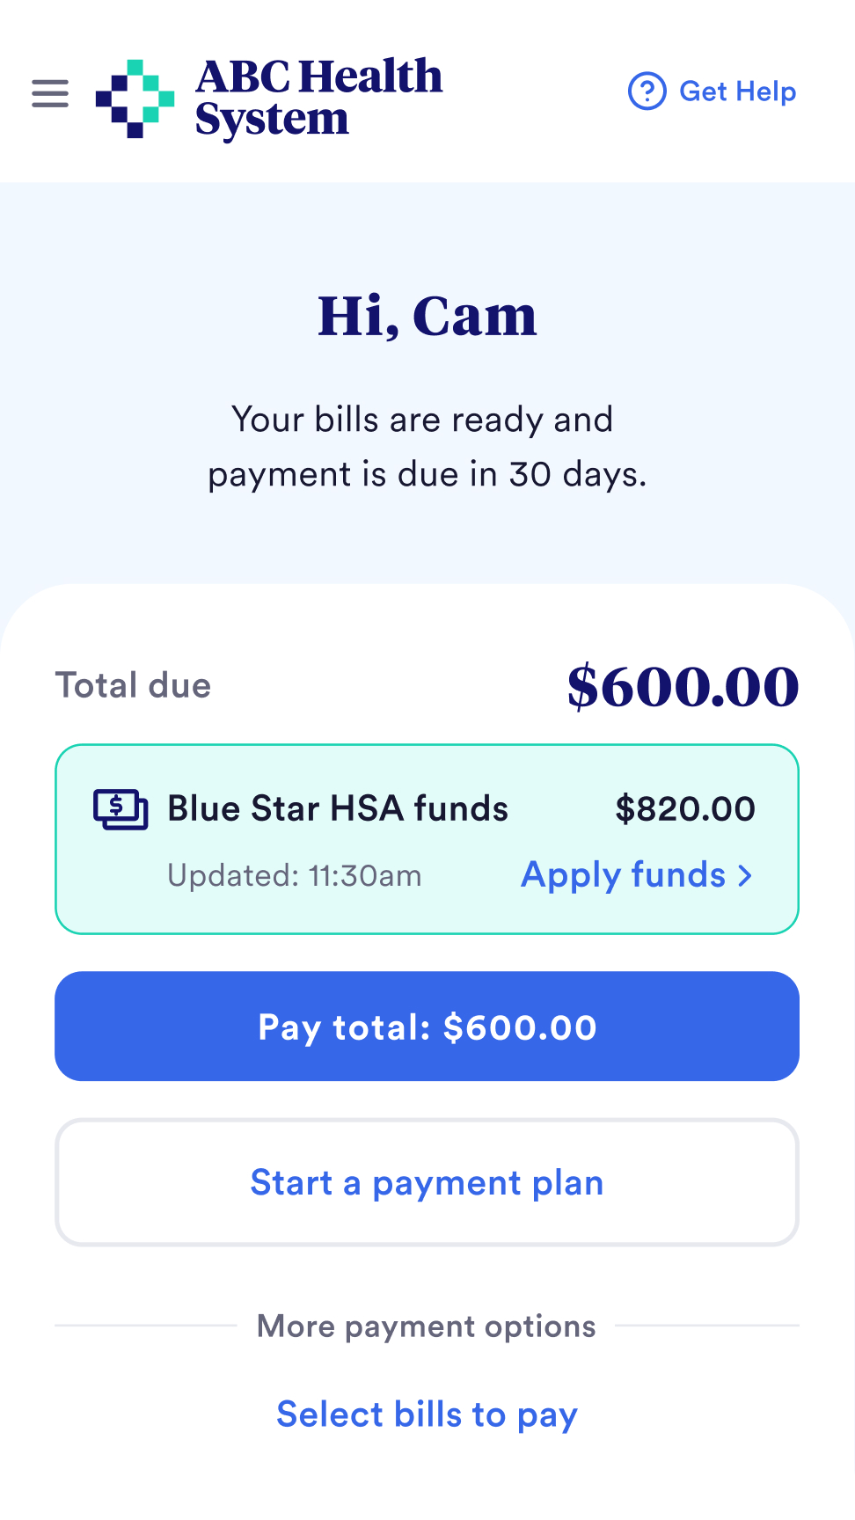

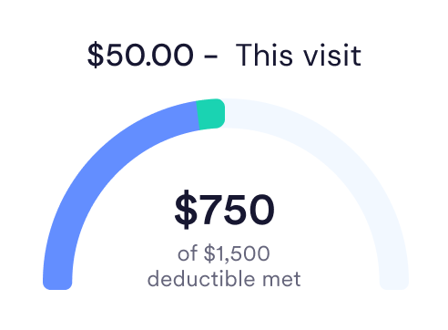
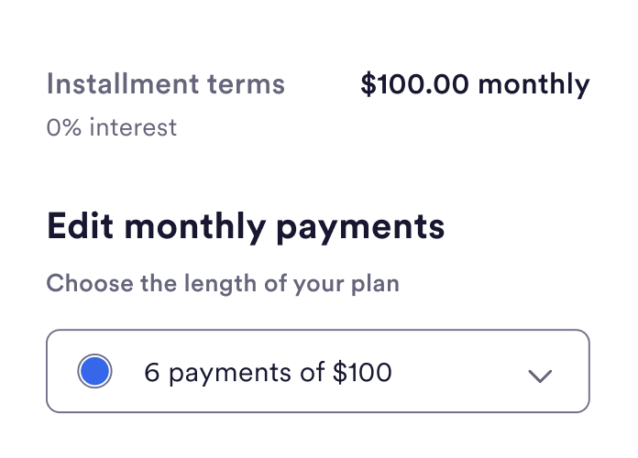
Cedar Pay
Helping patients resolve their bills and estimates simply
89%
avg patient satisfaction
94%
increase in digital self-service payments

Slide 5

Servicing to streamline accountability
and costs
Email, text & paper statements
All-in-one partner for the patient financial journey
IVR & payment processing
Call & chat center*
Dynamic discounting & payment plans

Slide 6
Call Center: Best in
class customer service
Customer Satisfaction
First Contact Resolution
Call Performance AHT Service Level, Abandon Rate, ASA
Cedar Average 3.94 3.40 industry average
Cedar Average ≥80%
SLA: ≥80% of calls answered ≤:60 secs
≤5.0% abandonment
Rather than focusing explicitly on industry standard ‘Time Based Metrics’ Cedar is focused 100% on Customer Experience

